Slide 1
Shortest Path Algorithms
Dijkstra, Bellman-Ford
Nahian Salsabil

Slide 2
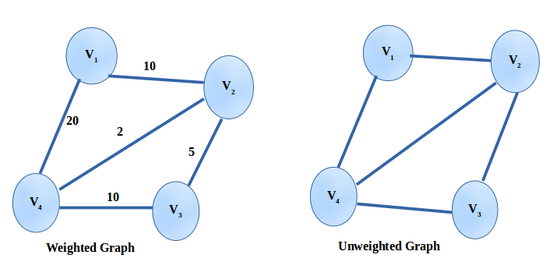
Weighted Graph

Slide 3
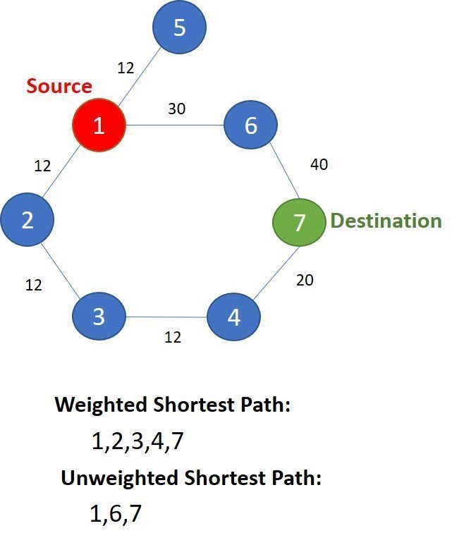
Weighted Graph and Shortest Path

Slide 4
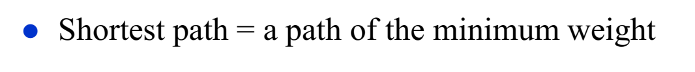
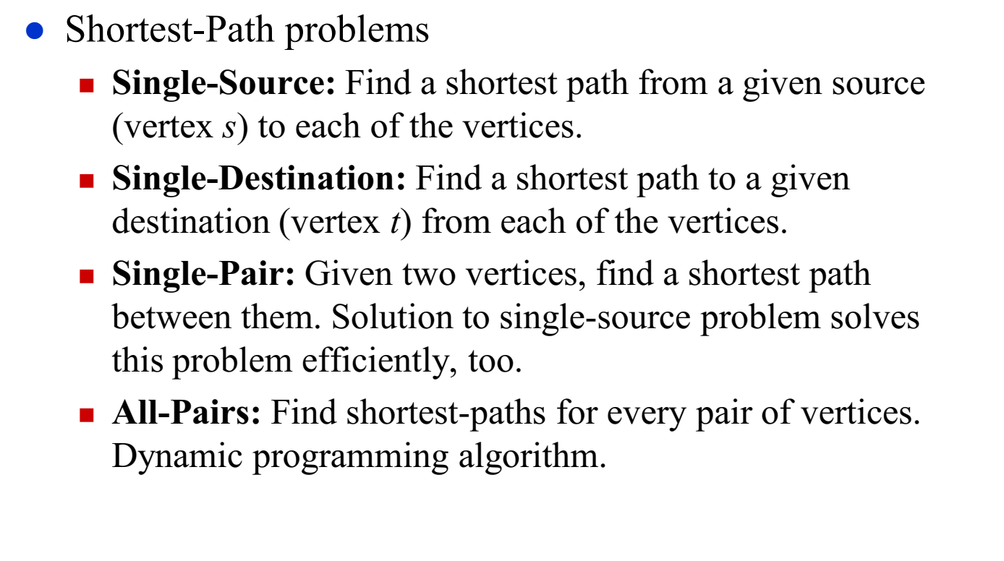
Shortest Path Problem

Slide 5
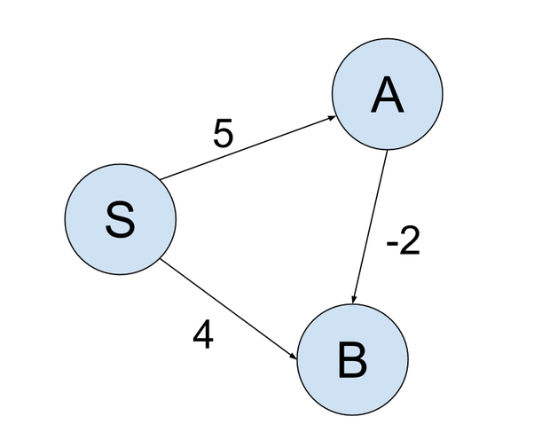
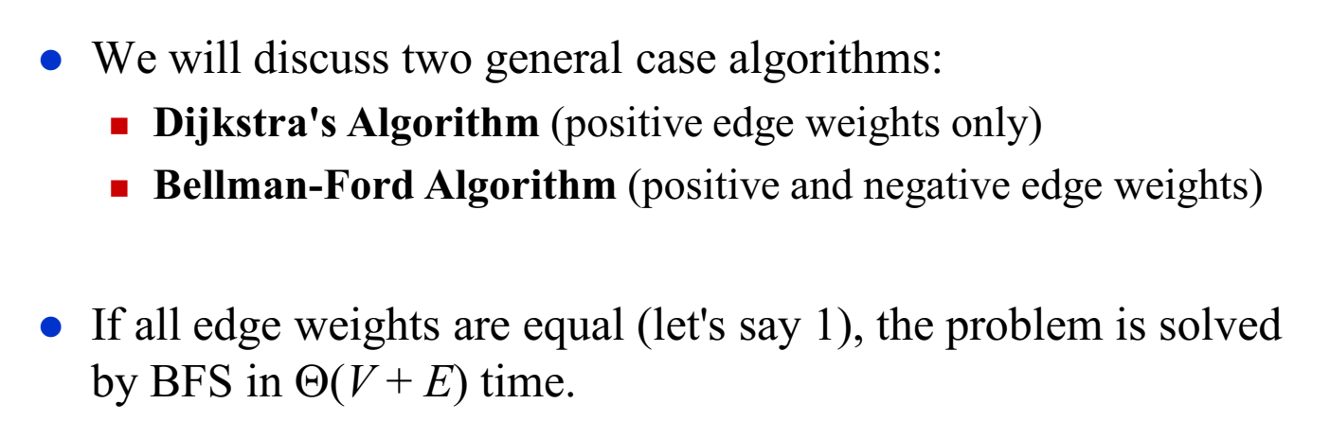
Single-Source Shortest Path Problem

Slide 6
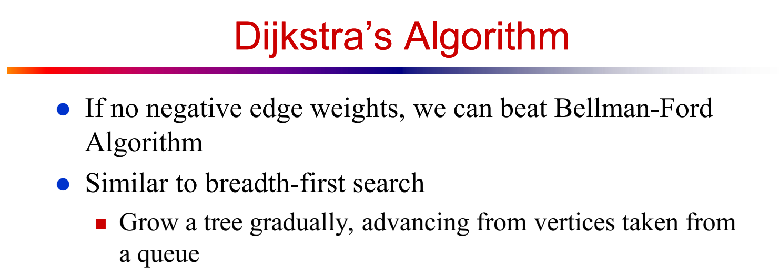

Slide 7
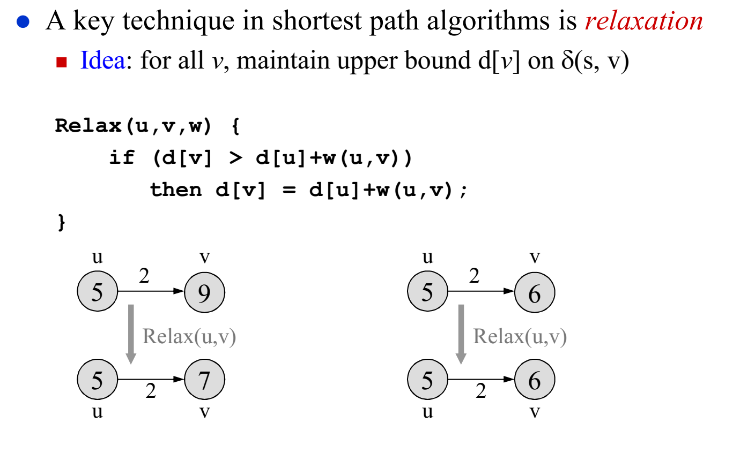
Relaxation
<Distance from source>
5+2 = 7 > 6
So, do not update
5+2 = 7 < 9
Update distance
of v to 7 from 9

Slide 8
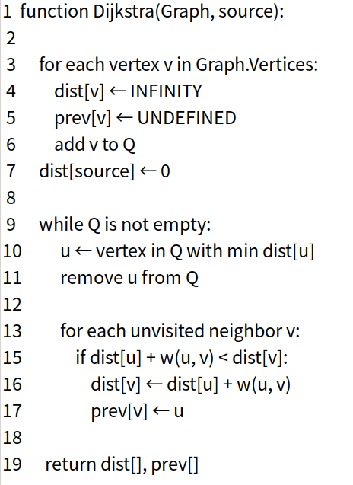
Dijkstra Algorithm Pseudocode
Very similar to BFS
Instead of regular Queue, we use Min Heap
Relaxation

Slide 9
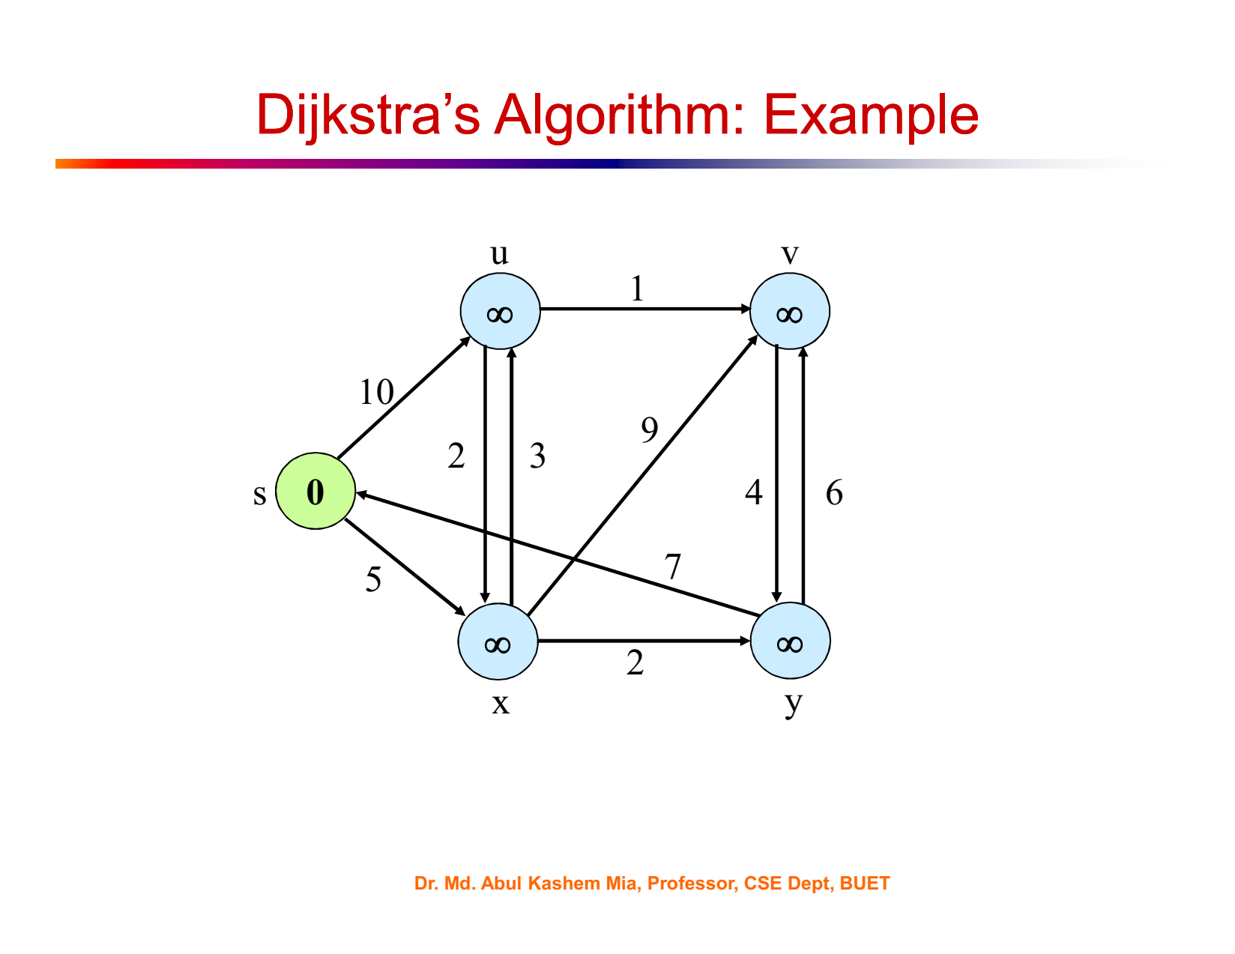

Slide 10
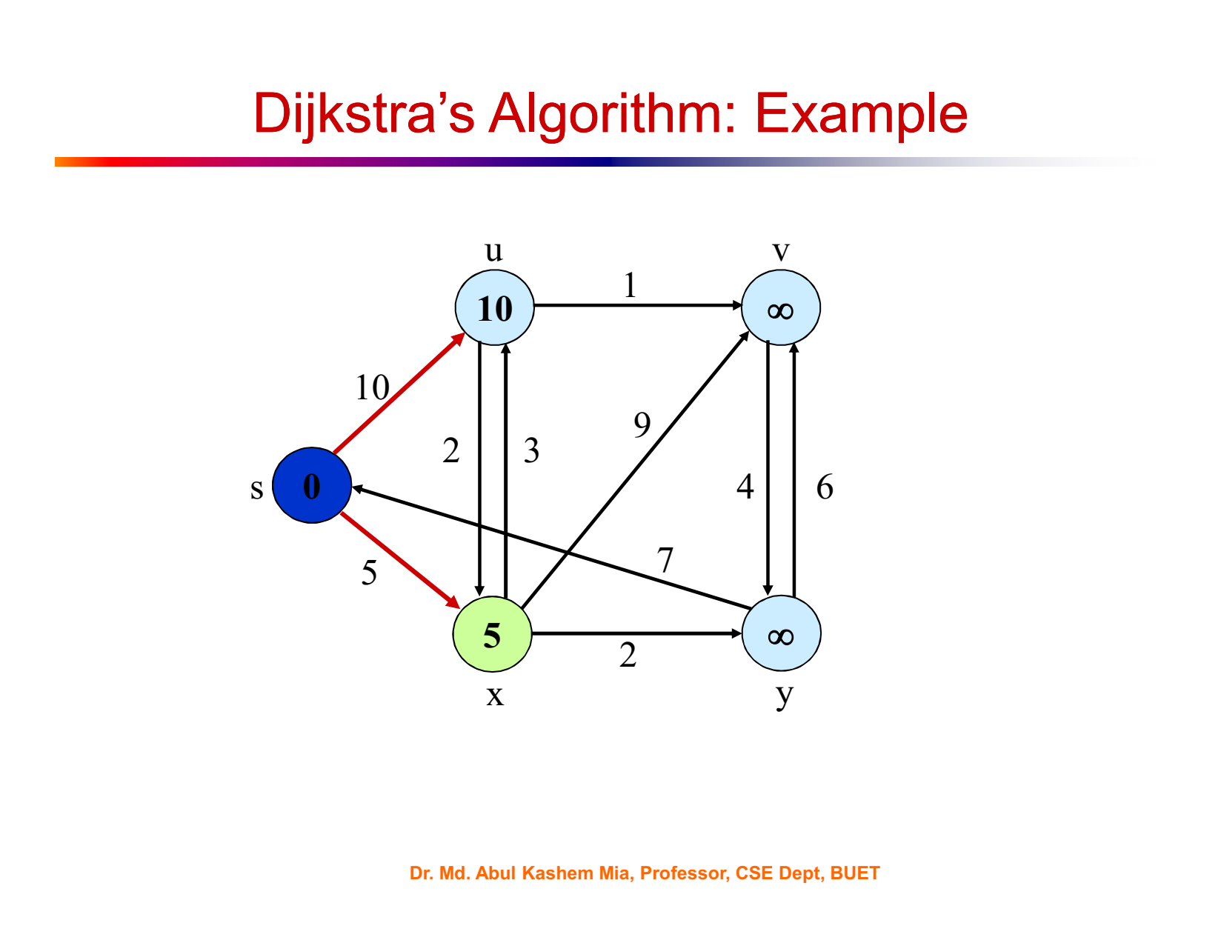

Slide 11
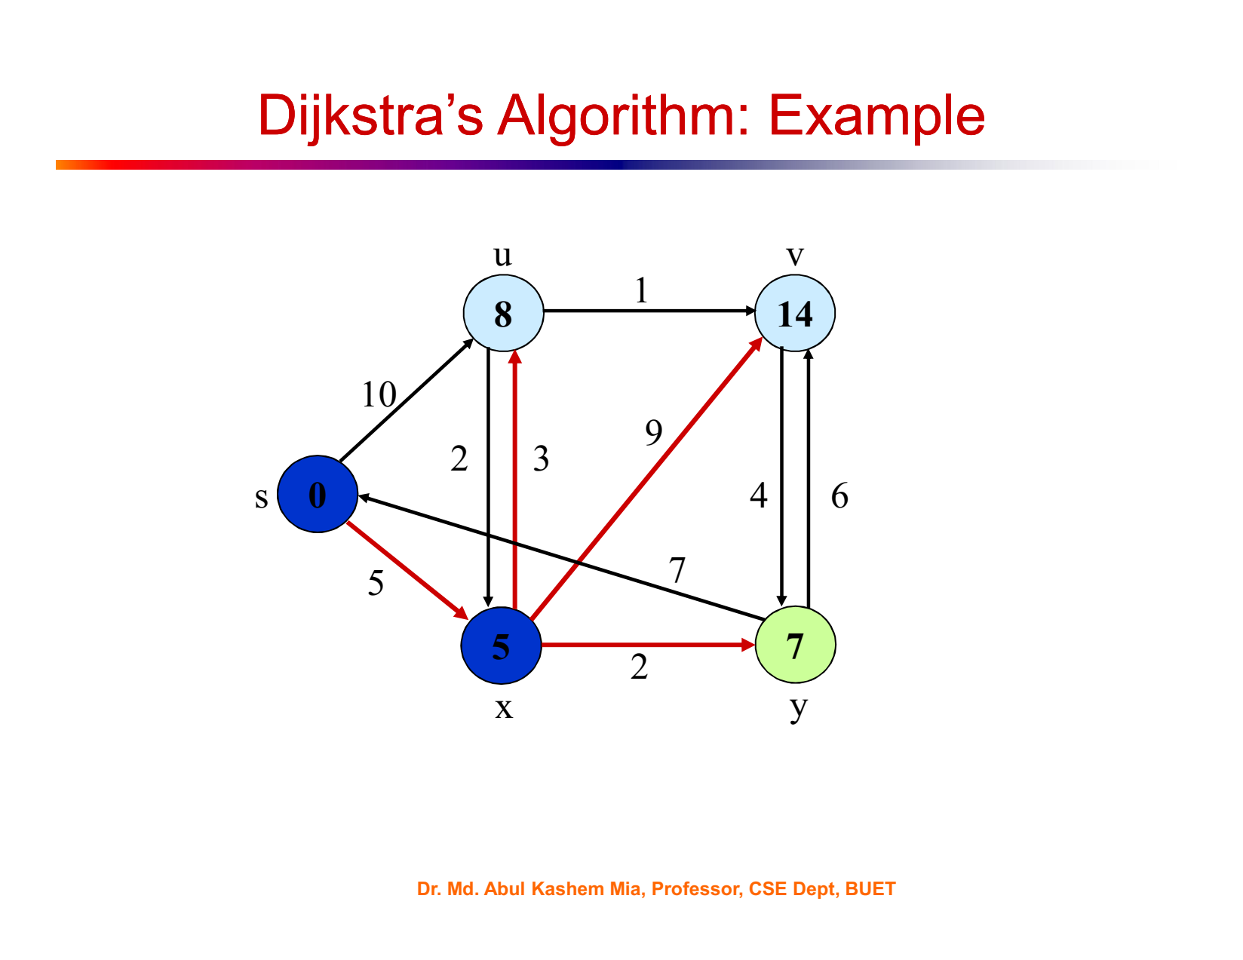

Slide 12
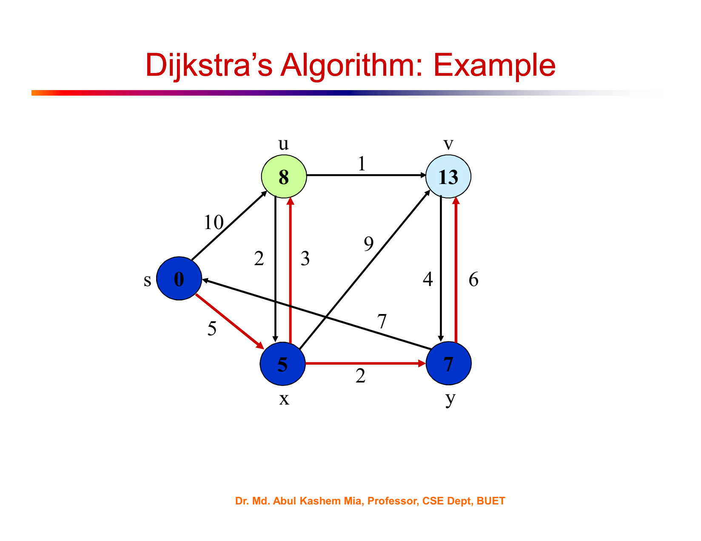

Slide 13
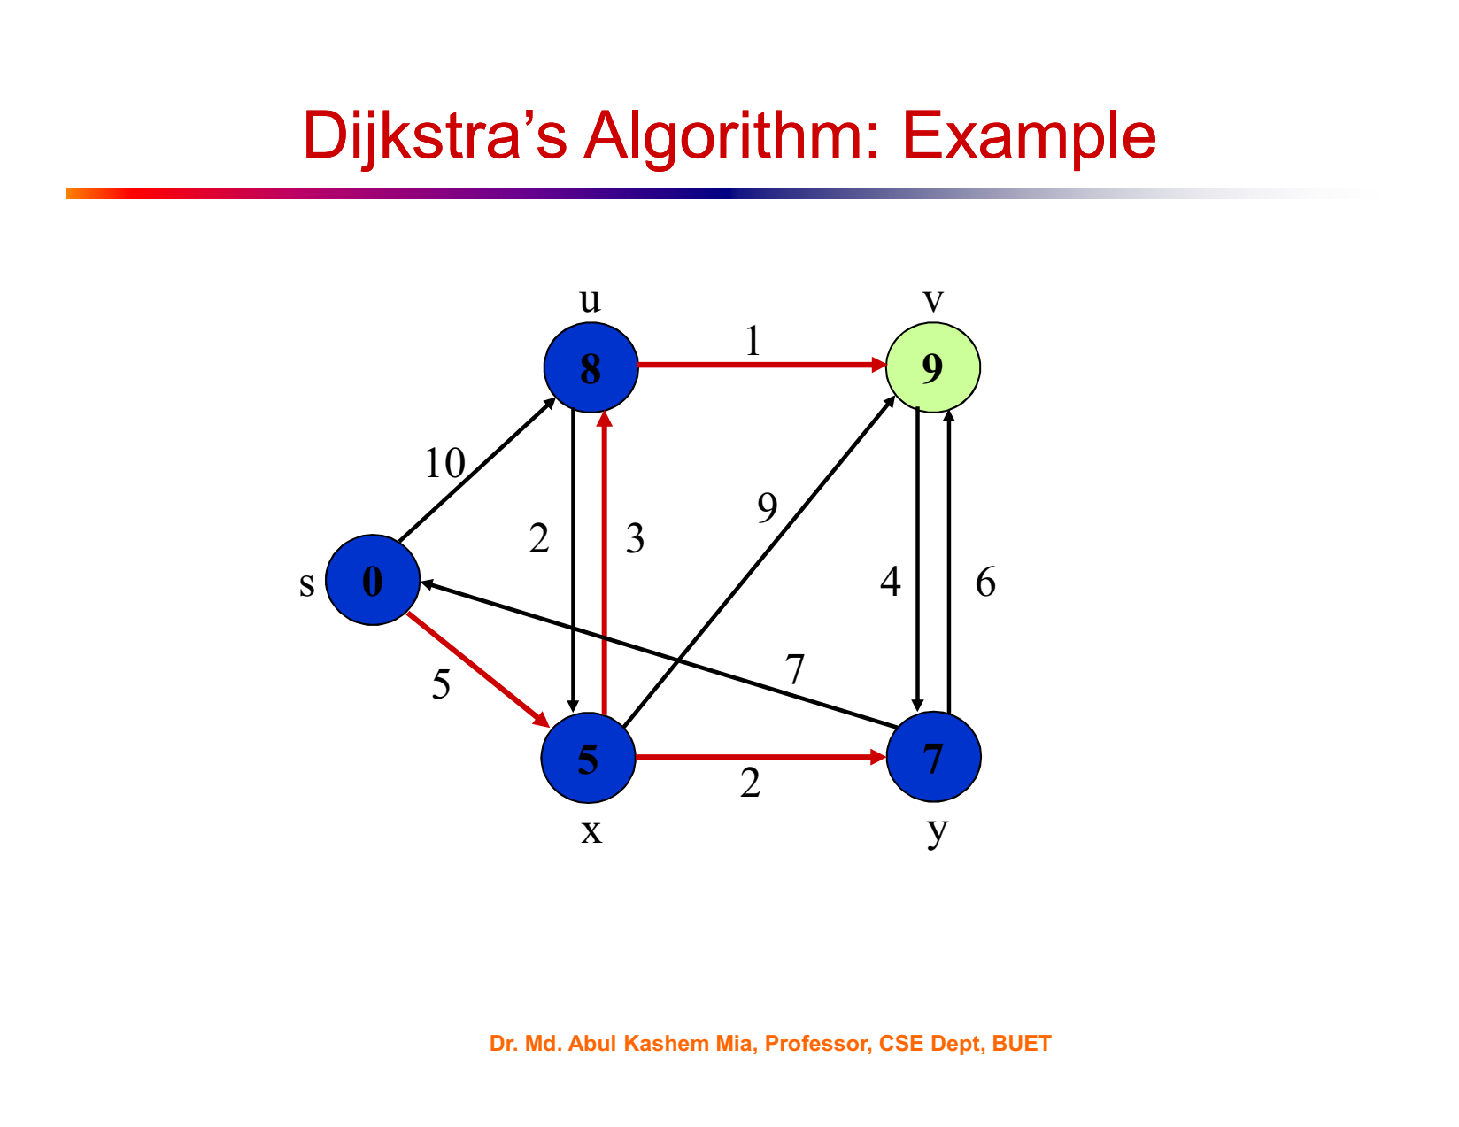

Slide 14
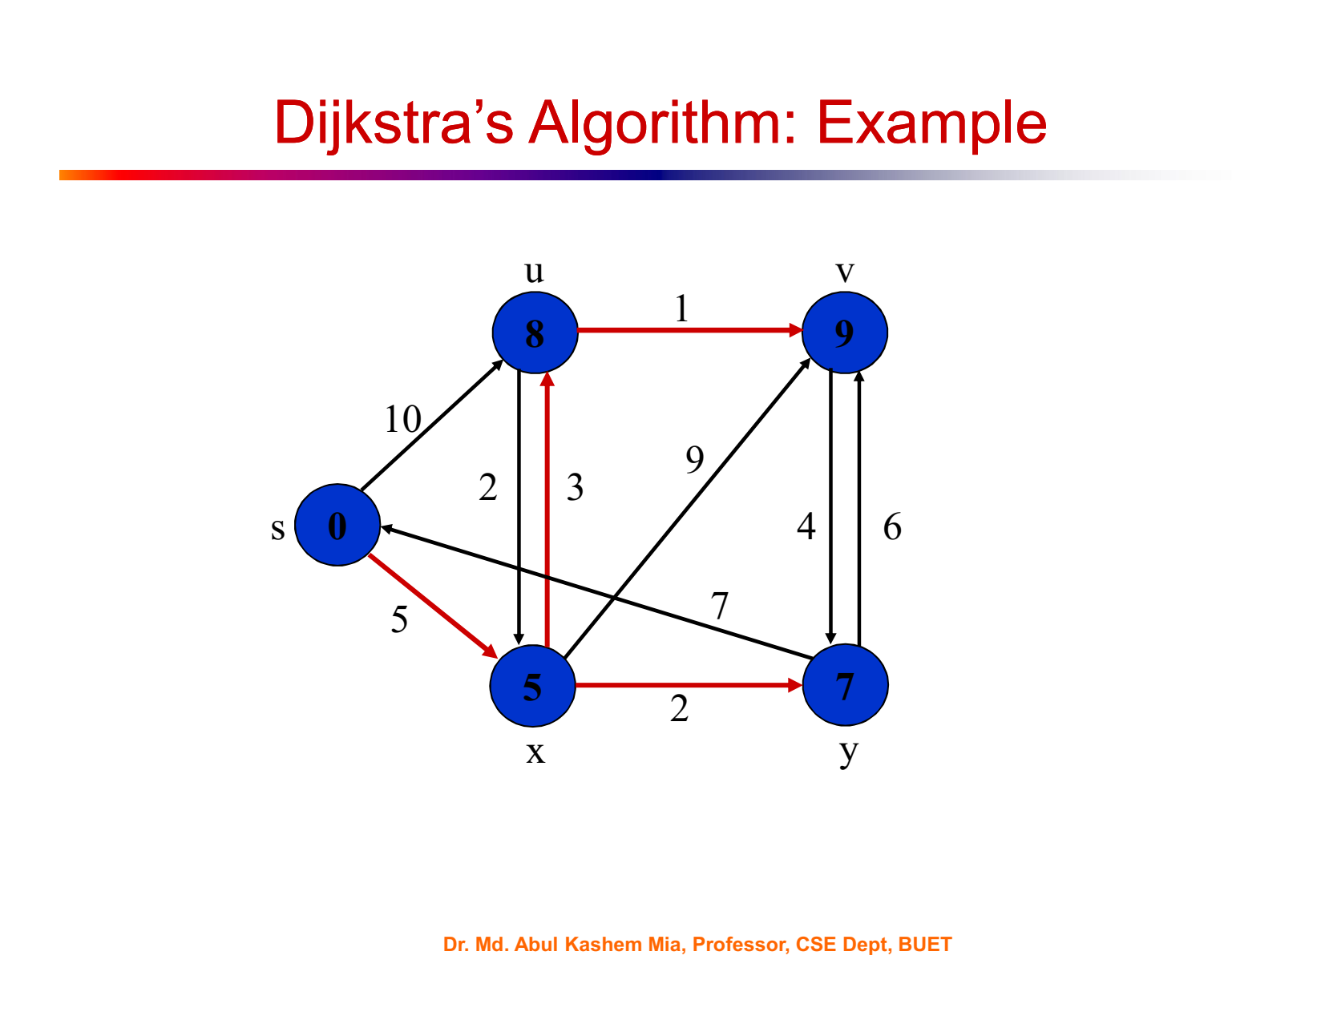

Slide 15
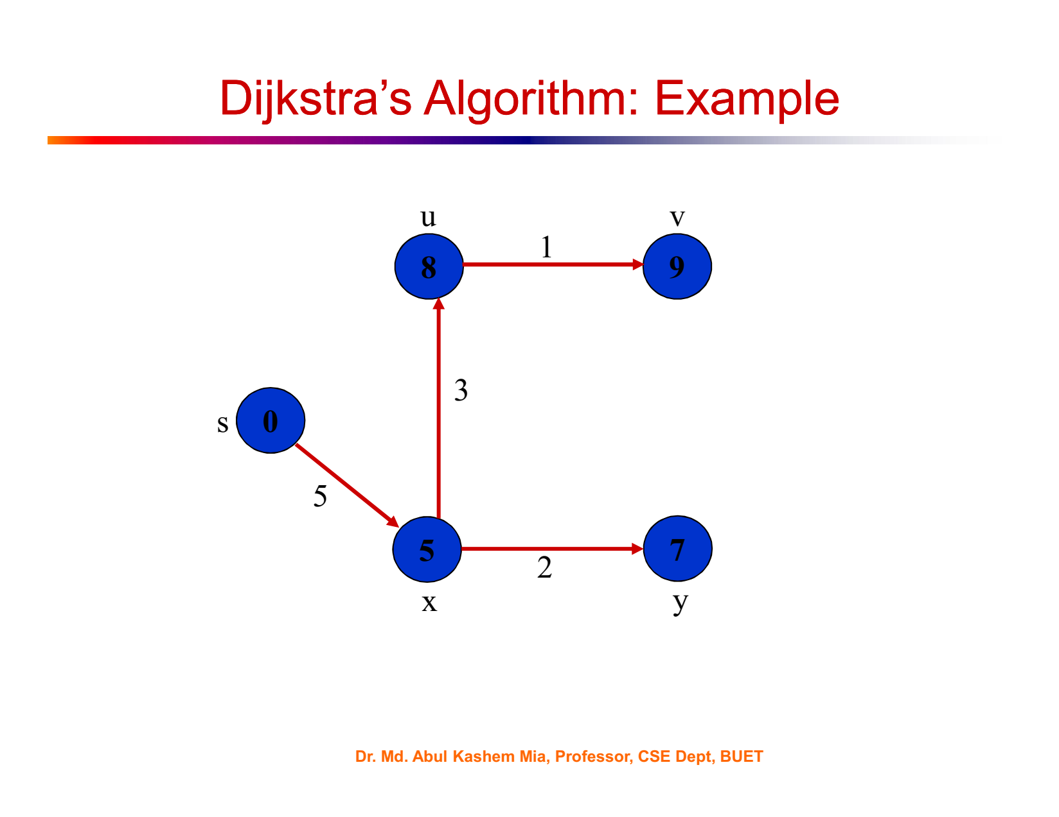

Slide 16
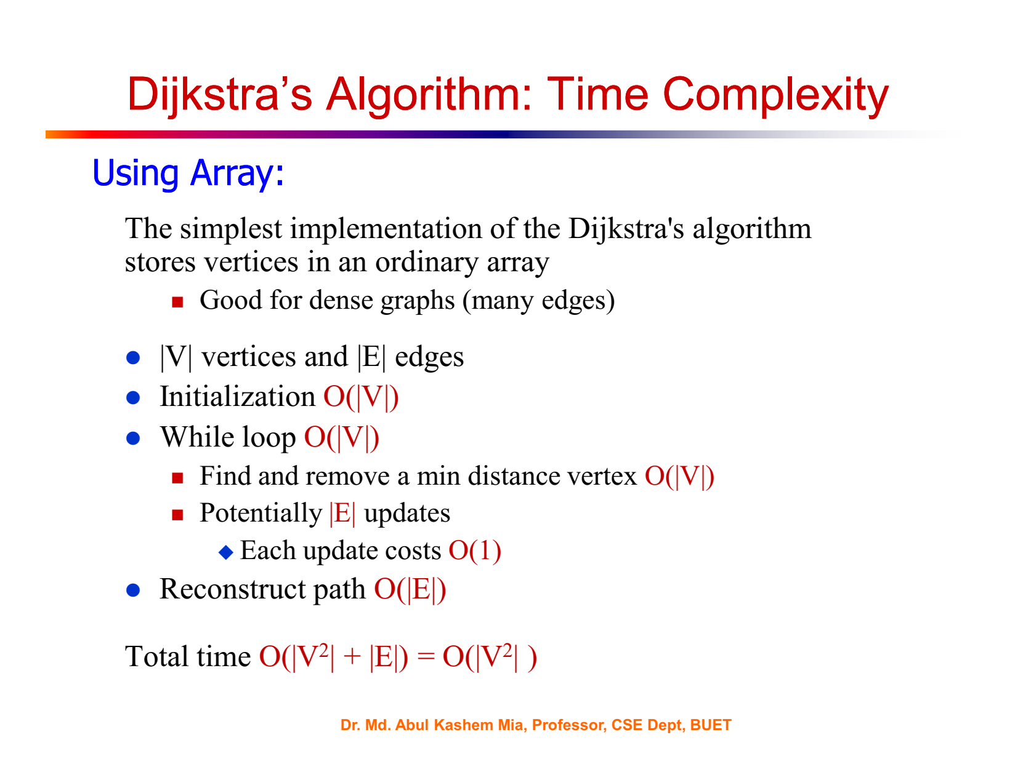

Slide 17
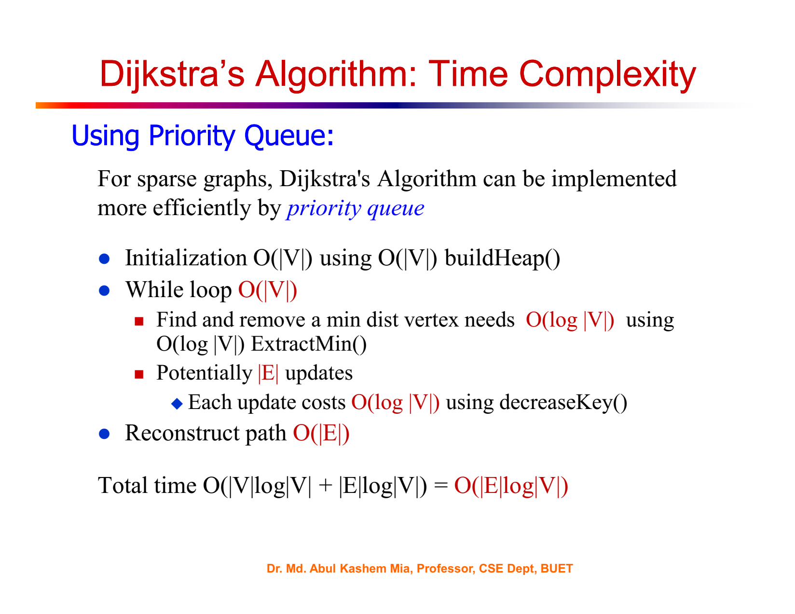

Slide 18
Example usage of Dijkstra's algorithm:
graph = {
'A': {'B': 1, 'C': 4},
'B': {'A': 1, 'C': 2, 'D': 5},
'C': {'A': 4, 'B': 2, 'D': 1},
'D': {'B': 5, 'C': 1}
}
start_vertex = 'A'
result = dijkstra(graph, start_vertex)
print(result)
# Output: {'A': 0, 'B': 1, 'C': 3, 'D': 4}

Slide 19
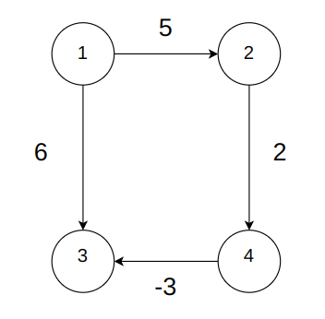
Limitation of Dijkstra
Might fail to find minimum distance in case of negative weights.
Example:

Slide 20
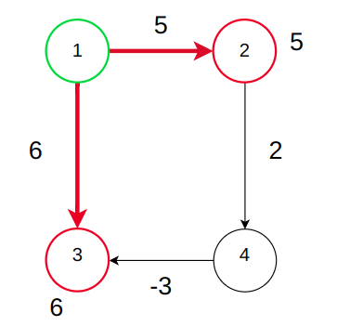
Limitation of Dijkstra
Might fail to find minimum distance in case of negative weights.
Example:

Slide 21
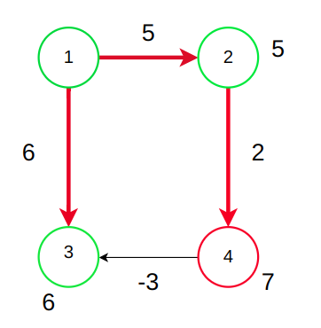
Limitation of Dijkstra
Might fail to find minimum distance in case of negative weights.
Example:
Dijkstra will not relax this edge because vertex 3 is already visited. But if it is checked, the distance of vertex 3 should become 7-3 = 4. So dijkstra cannot give correct answer in this case.

Slide 22
Limitation of Dijkstra
Might fail to find minimum distance in case of negative weights.
So, Dijkstra may or may not give the correct result for negative edge weights.
Solution: Bellman Ford

Slide 23
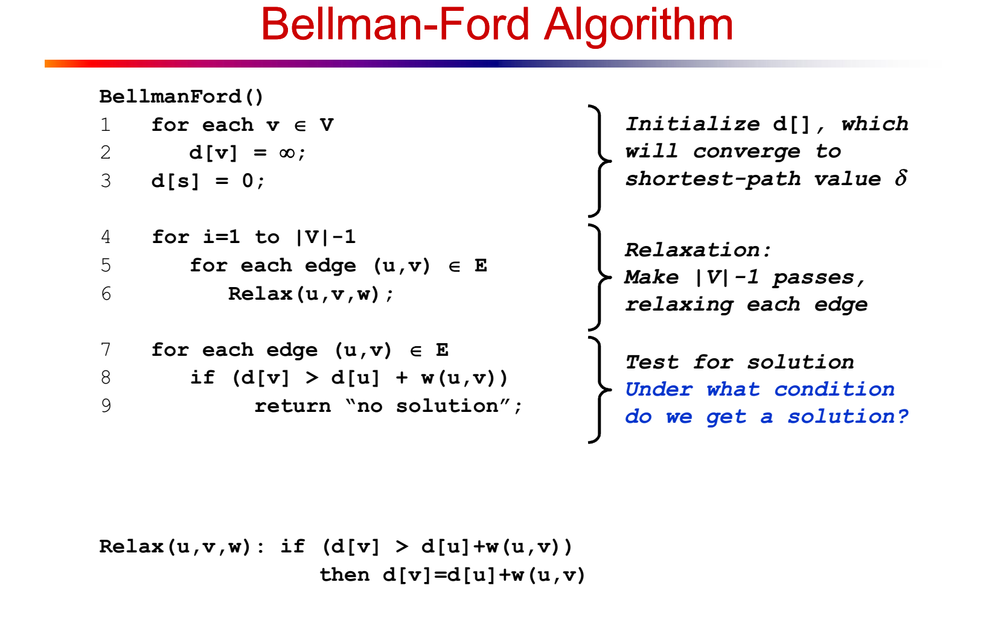
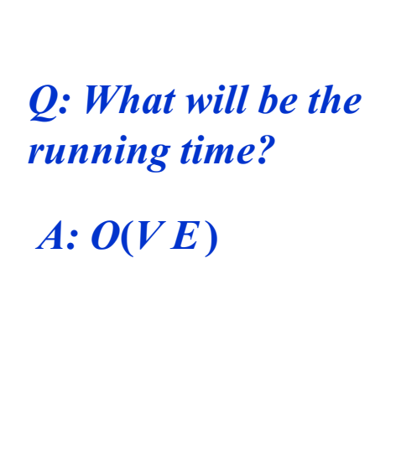

Slide 24
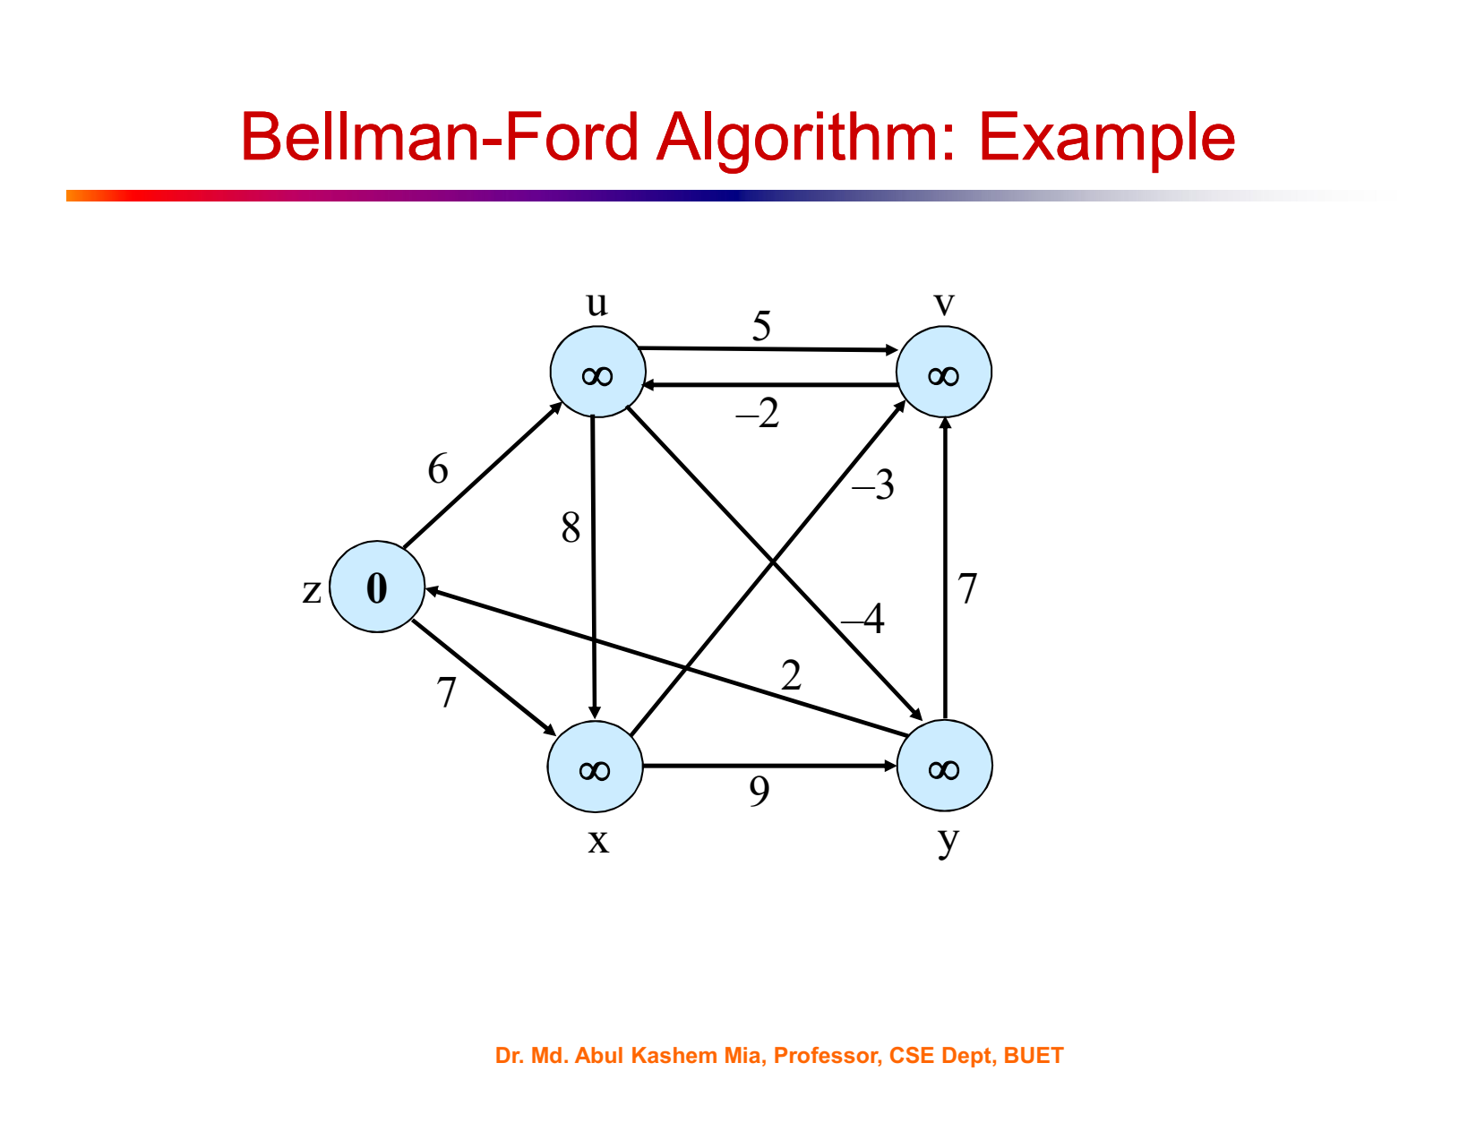
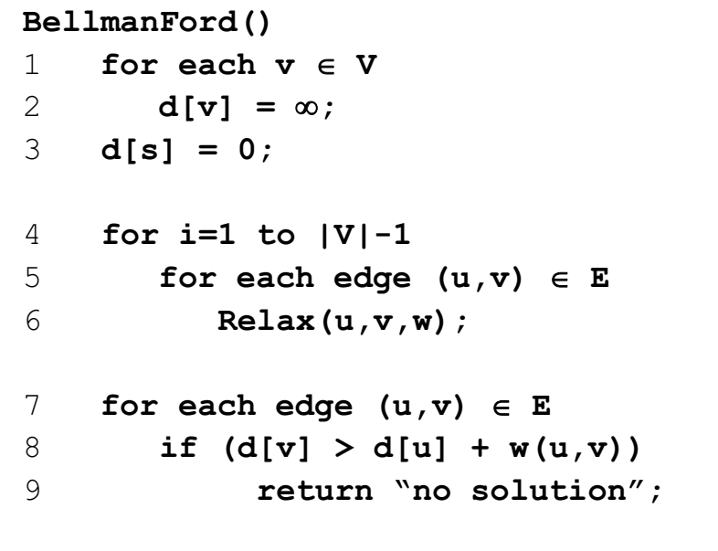

Slide 25
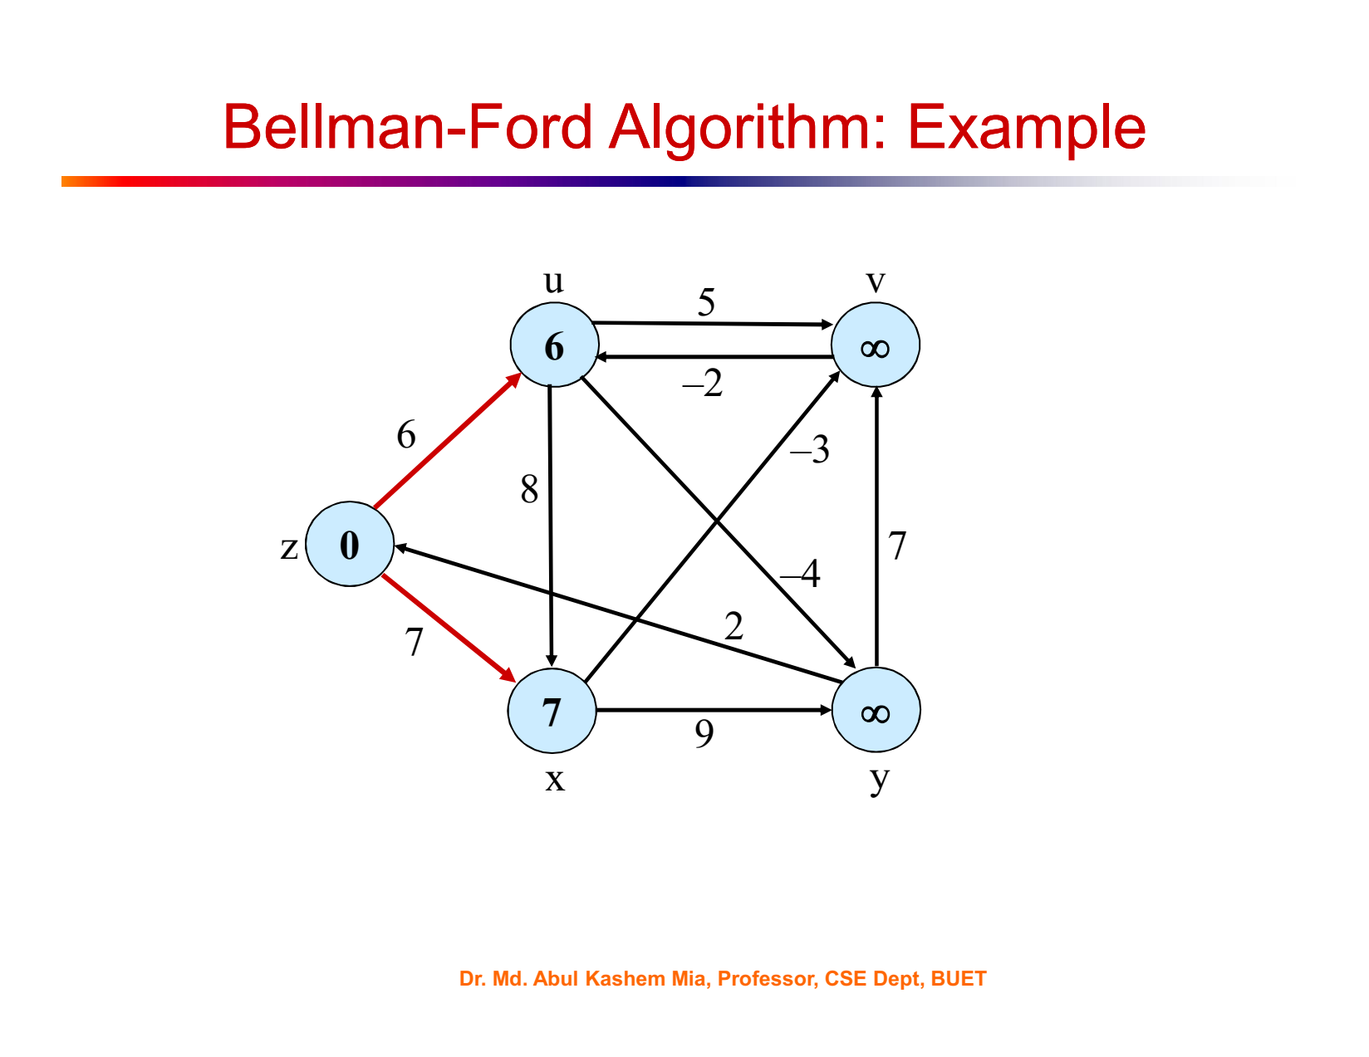

Slide 26
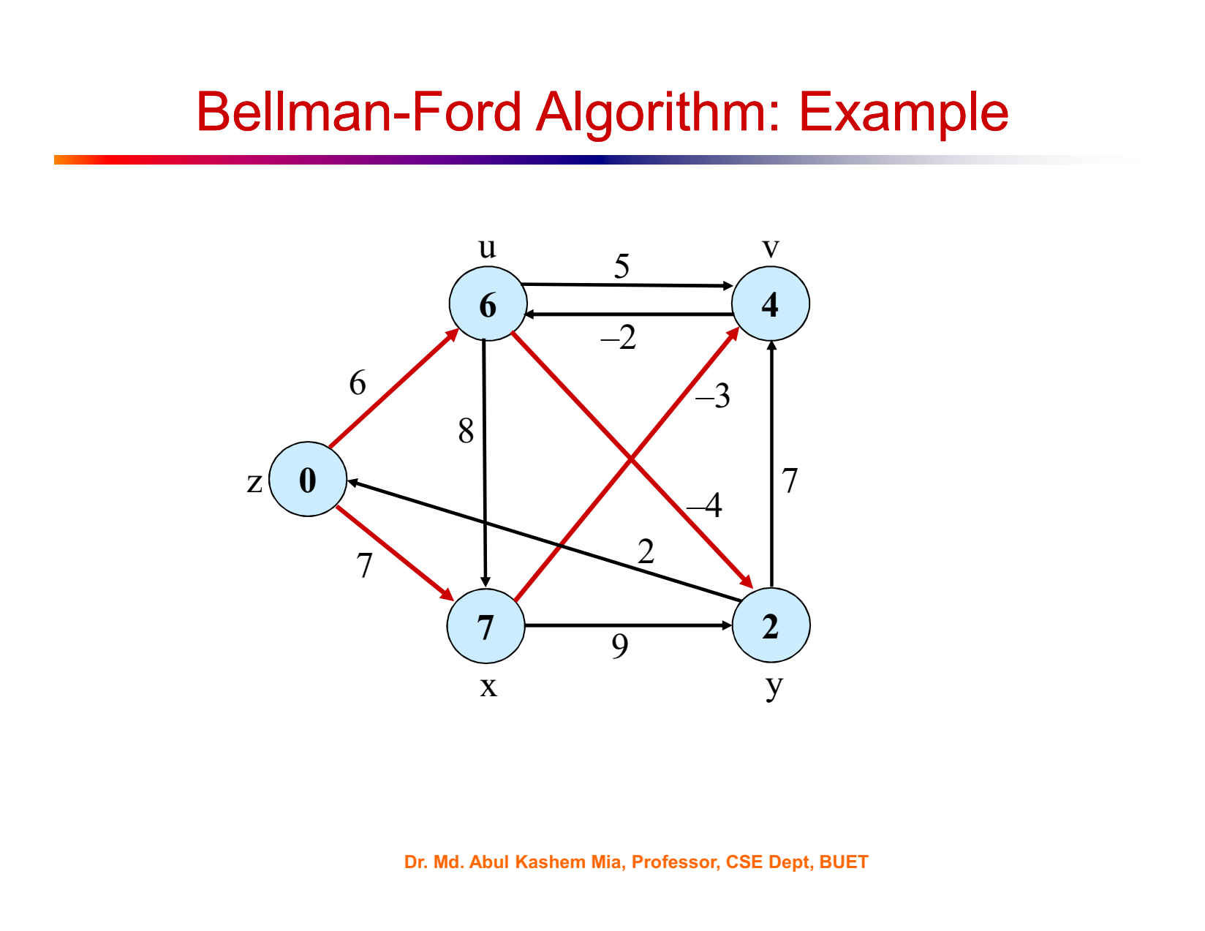

Slide 27
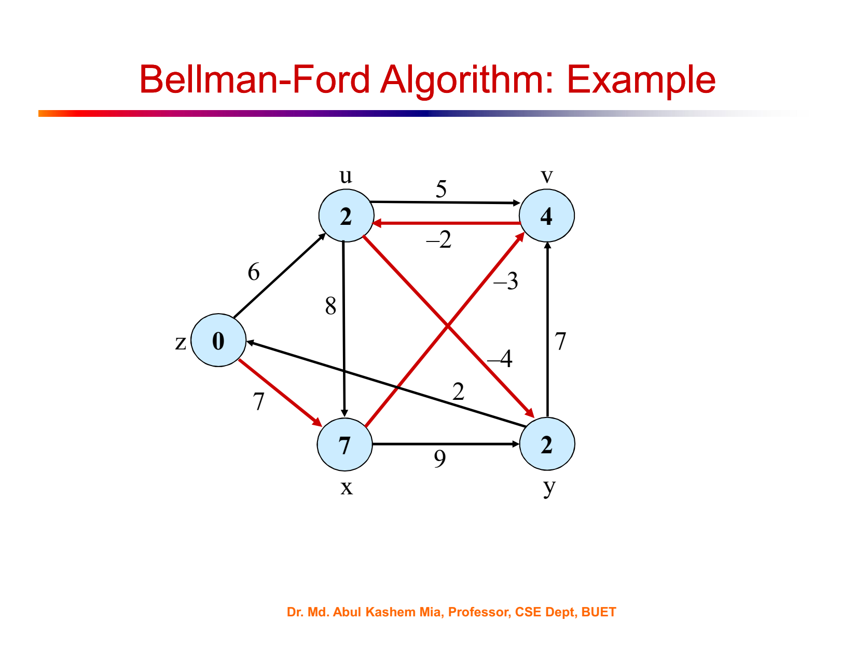

Slide 28


Slide 29
Limitation of Bellman Ford Algorithm
Cannot find shortest path for negative weight cycle.
After passing |V| - 1 times, there will still be some vertex, for which we did not yet reach the minimum distance. If we continue to run the algorithm again and again, it will keep decreasing. So, there will be no shortest path.

Slide 30
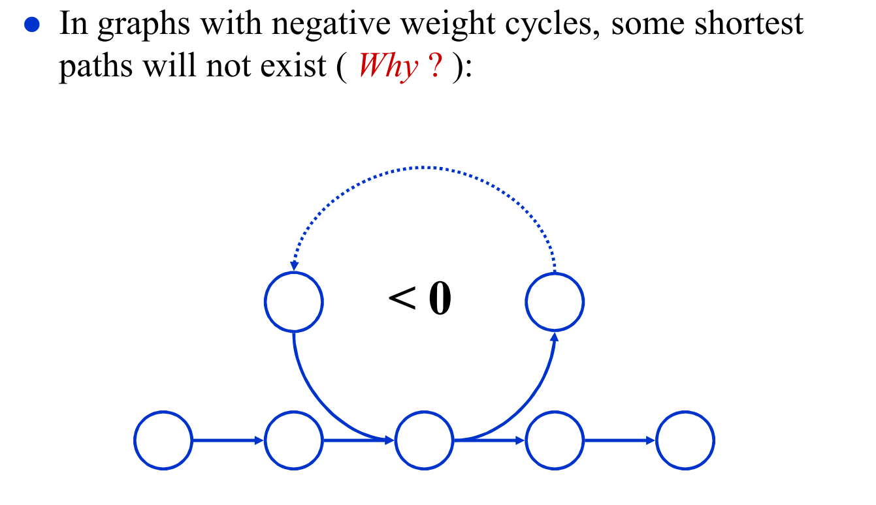
Negative Weight Cycle
If there is a cycle for which the total weight is negative, then Bellman Ford cannot find the shortest path.

Slide 31
Negative Weight Cycle
Suppose the graph has vertices like these
3
-6
2
S
T
1
3

Slide 32
Negative Weight Cycle
path | distance
1 | 4
Suppose the graph has more vertices like these
3
-6
2
S
T
1
1
3
Distance = 1+3 =4

Slide 33
Negative Weight Cycle
path | distance
1 | 4
2 | 3
Suppose the graph has more vertices like these
3
-6
2
S
T
1
1
3
Distance = 1-6+3+2+3 = 3

Slide 34
Negative Weight Cycle
path | distance
1 | 4
2 | 3
3 | 2
Suppose the graph has more vertices like these
3
-6
2
S
T
1
1
3
Will keep going reducing the distance, therefore shortest path cannot be found
Distance = 1-6+3+2-6+3+2+3 = 2

Slide 35
Negative Weight Cycle
Suppose the graph has more vertices like these
There is a cycle here and for this cycle the total weight is
3 + 2 - 6 = -1. Since the total weight is negative, it will form a negative weight cycle and there will be no shortest path.
3
-6
2
S
T
1
3

Slide 36
Limitation of Bellman Ford Algorithm
This additional checking finds out if there is any negative weight cycle and in this case, there will be no solution.

Slide 37
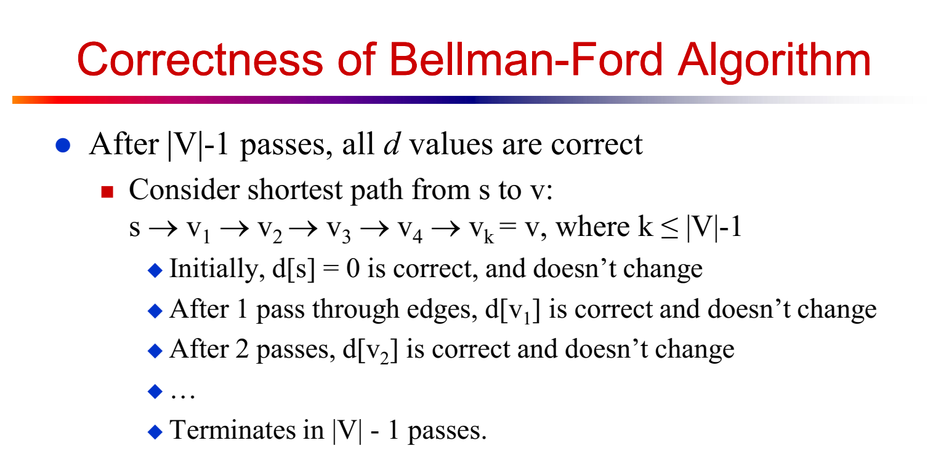

Slide 38
Time Complexity of Bellman Ford
Relax |E| edges for |V| - 1 times. So time complexity is O(|E|*(|V|-1)) = O(|E||V|) = O(n²).
If the graph is dense that means, if there are edges between all pairs of vertices, then |E| = n*(n-1)/2. SO the time complexity becomes O(n³).
Thus Bellman-Ford takes more time than dijkstra but it ensures the correct result.

Slide 39
Example usage of Bellman-Ford algorithm:
graph = {
'A': {'B': 1, 'C': 4},
'B': {'C': 2, 'D': 5},
'C': {'D': 1},
'D': {'B': -10}
}
start_vertex = 'A'
result = bellman_ford(graph, start_vertex)
print(result)
# Output: {'A': 0, 'B': -9, 'C': -8, 'D': -7}

